Slide 1
GitGud
CITY BUILDER

Slide 2
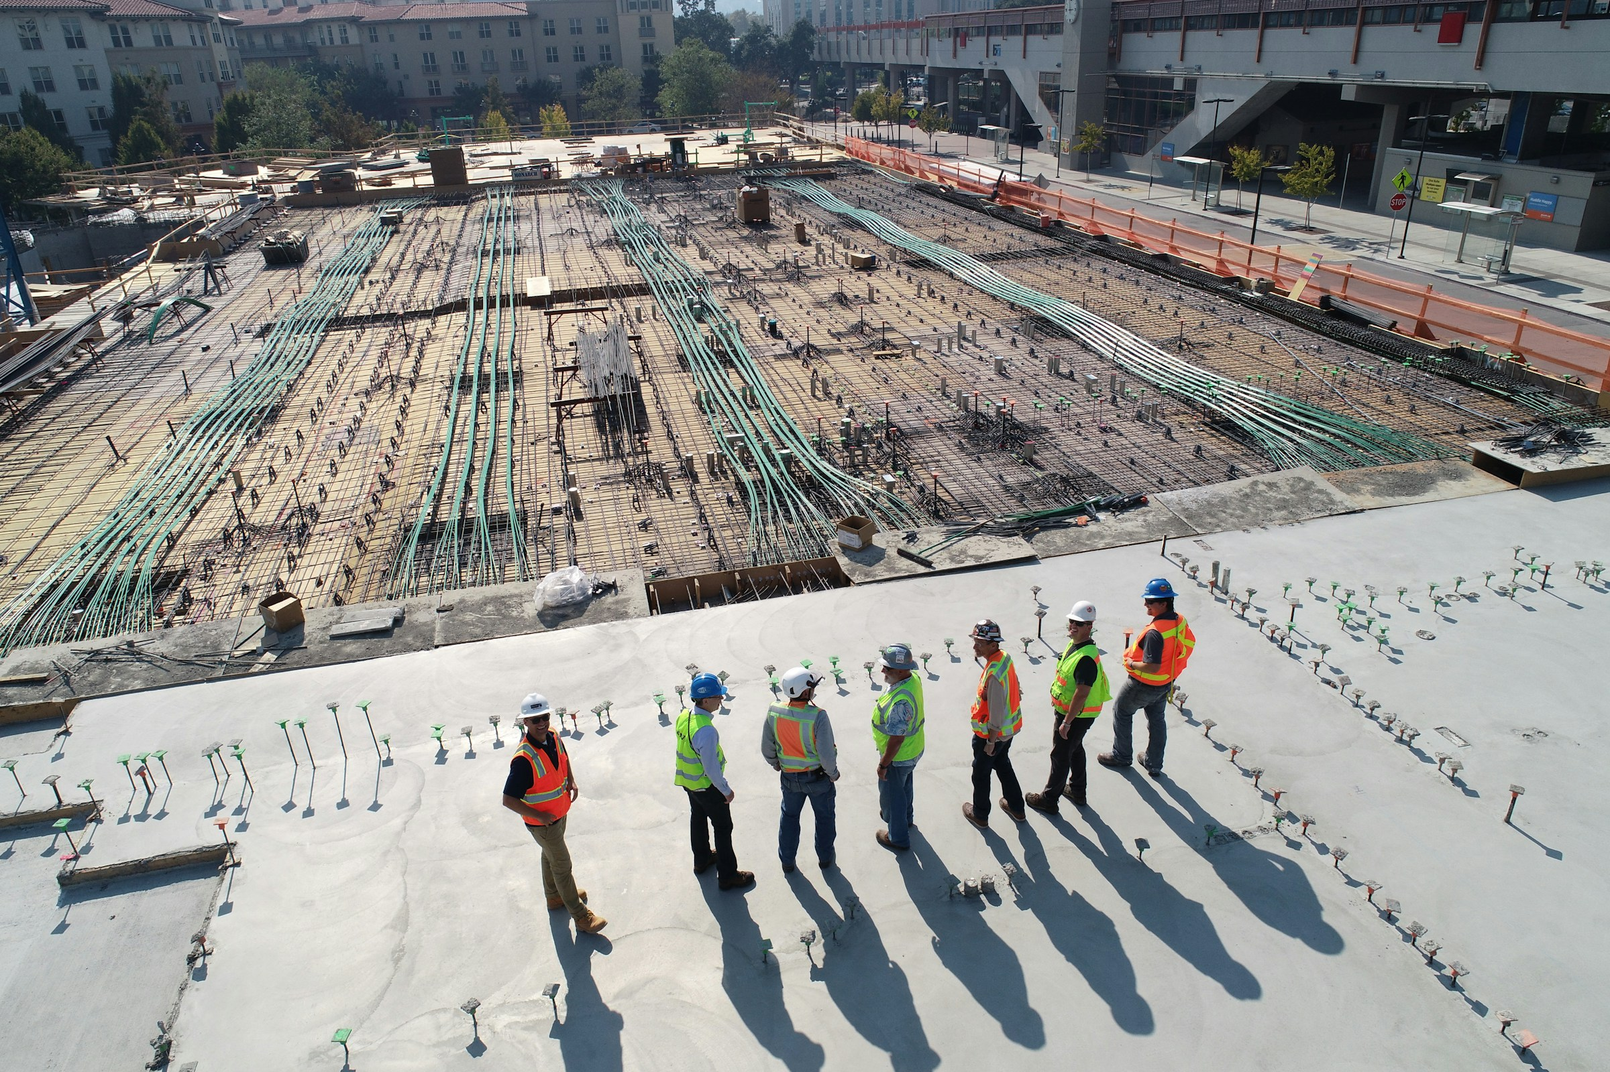
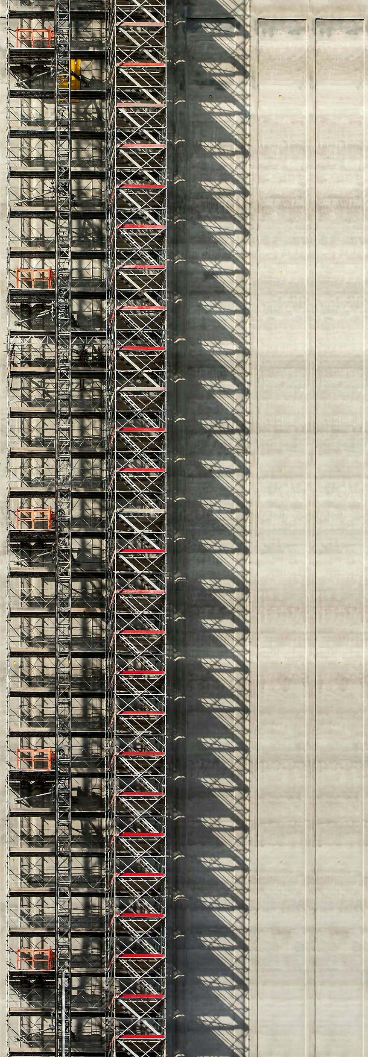
CITY BUILDER

Slide 3


REPORT

Slide 4

INTRODUCTION
The City Builder Simulation System is designed to let users build, expand, and manage a virtual city through realistic resource management and strategic planning. Players allocate resources, manage utility infrastructures, and develop residential, commercial, and industrial zones to foster a balanced and thriving environment. The system integrates key game design patterns, including a Memento pattern to save and restore the city’s state, allowing users to revisit past configurations. This framework encourages players to experiment with urban planning and infrastructure management, promoting sustainable growth and optimized city performance.

Slide 5
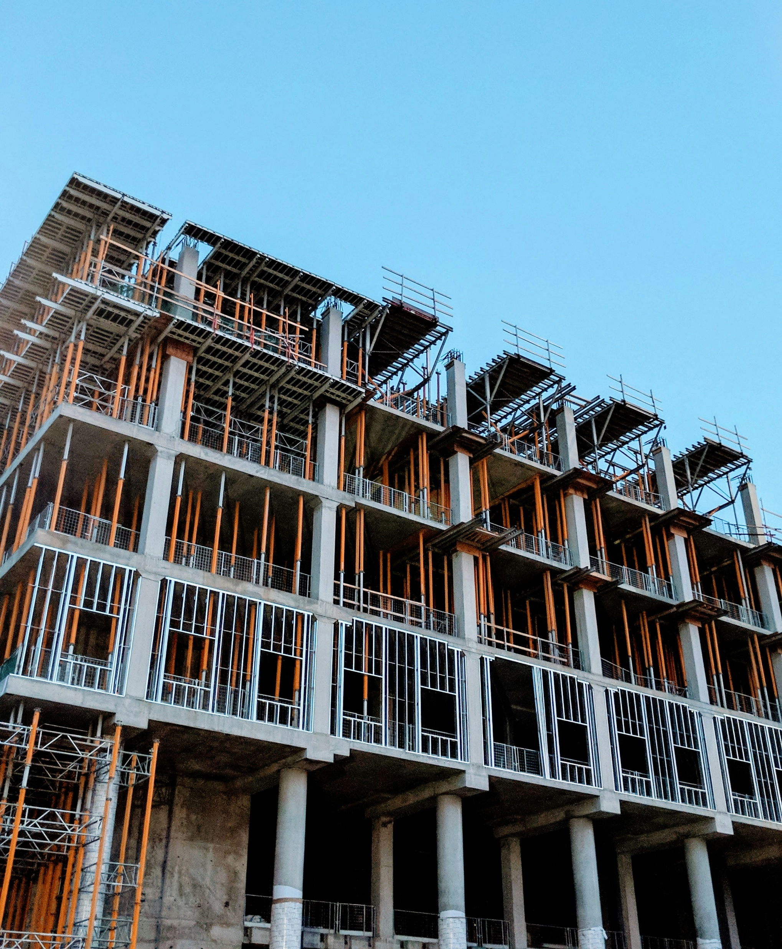
RESEARCH

Slide 6


PROGRAMMING STANDARDS
C++ Version 17
Usage Conventions
Naming Conventions
GitHub Flow Branching Strategy

Slide 7

FUNCTIONAL
REQUIREMENTS

Slide 8
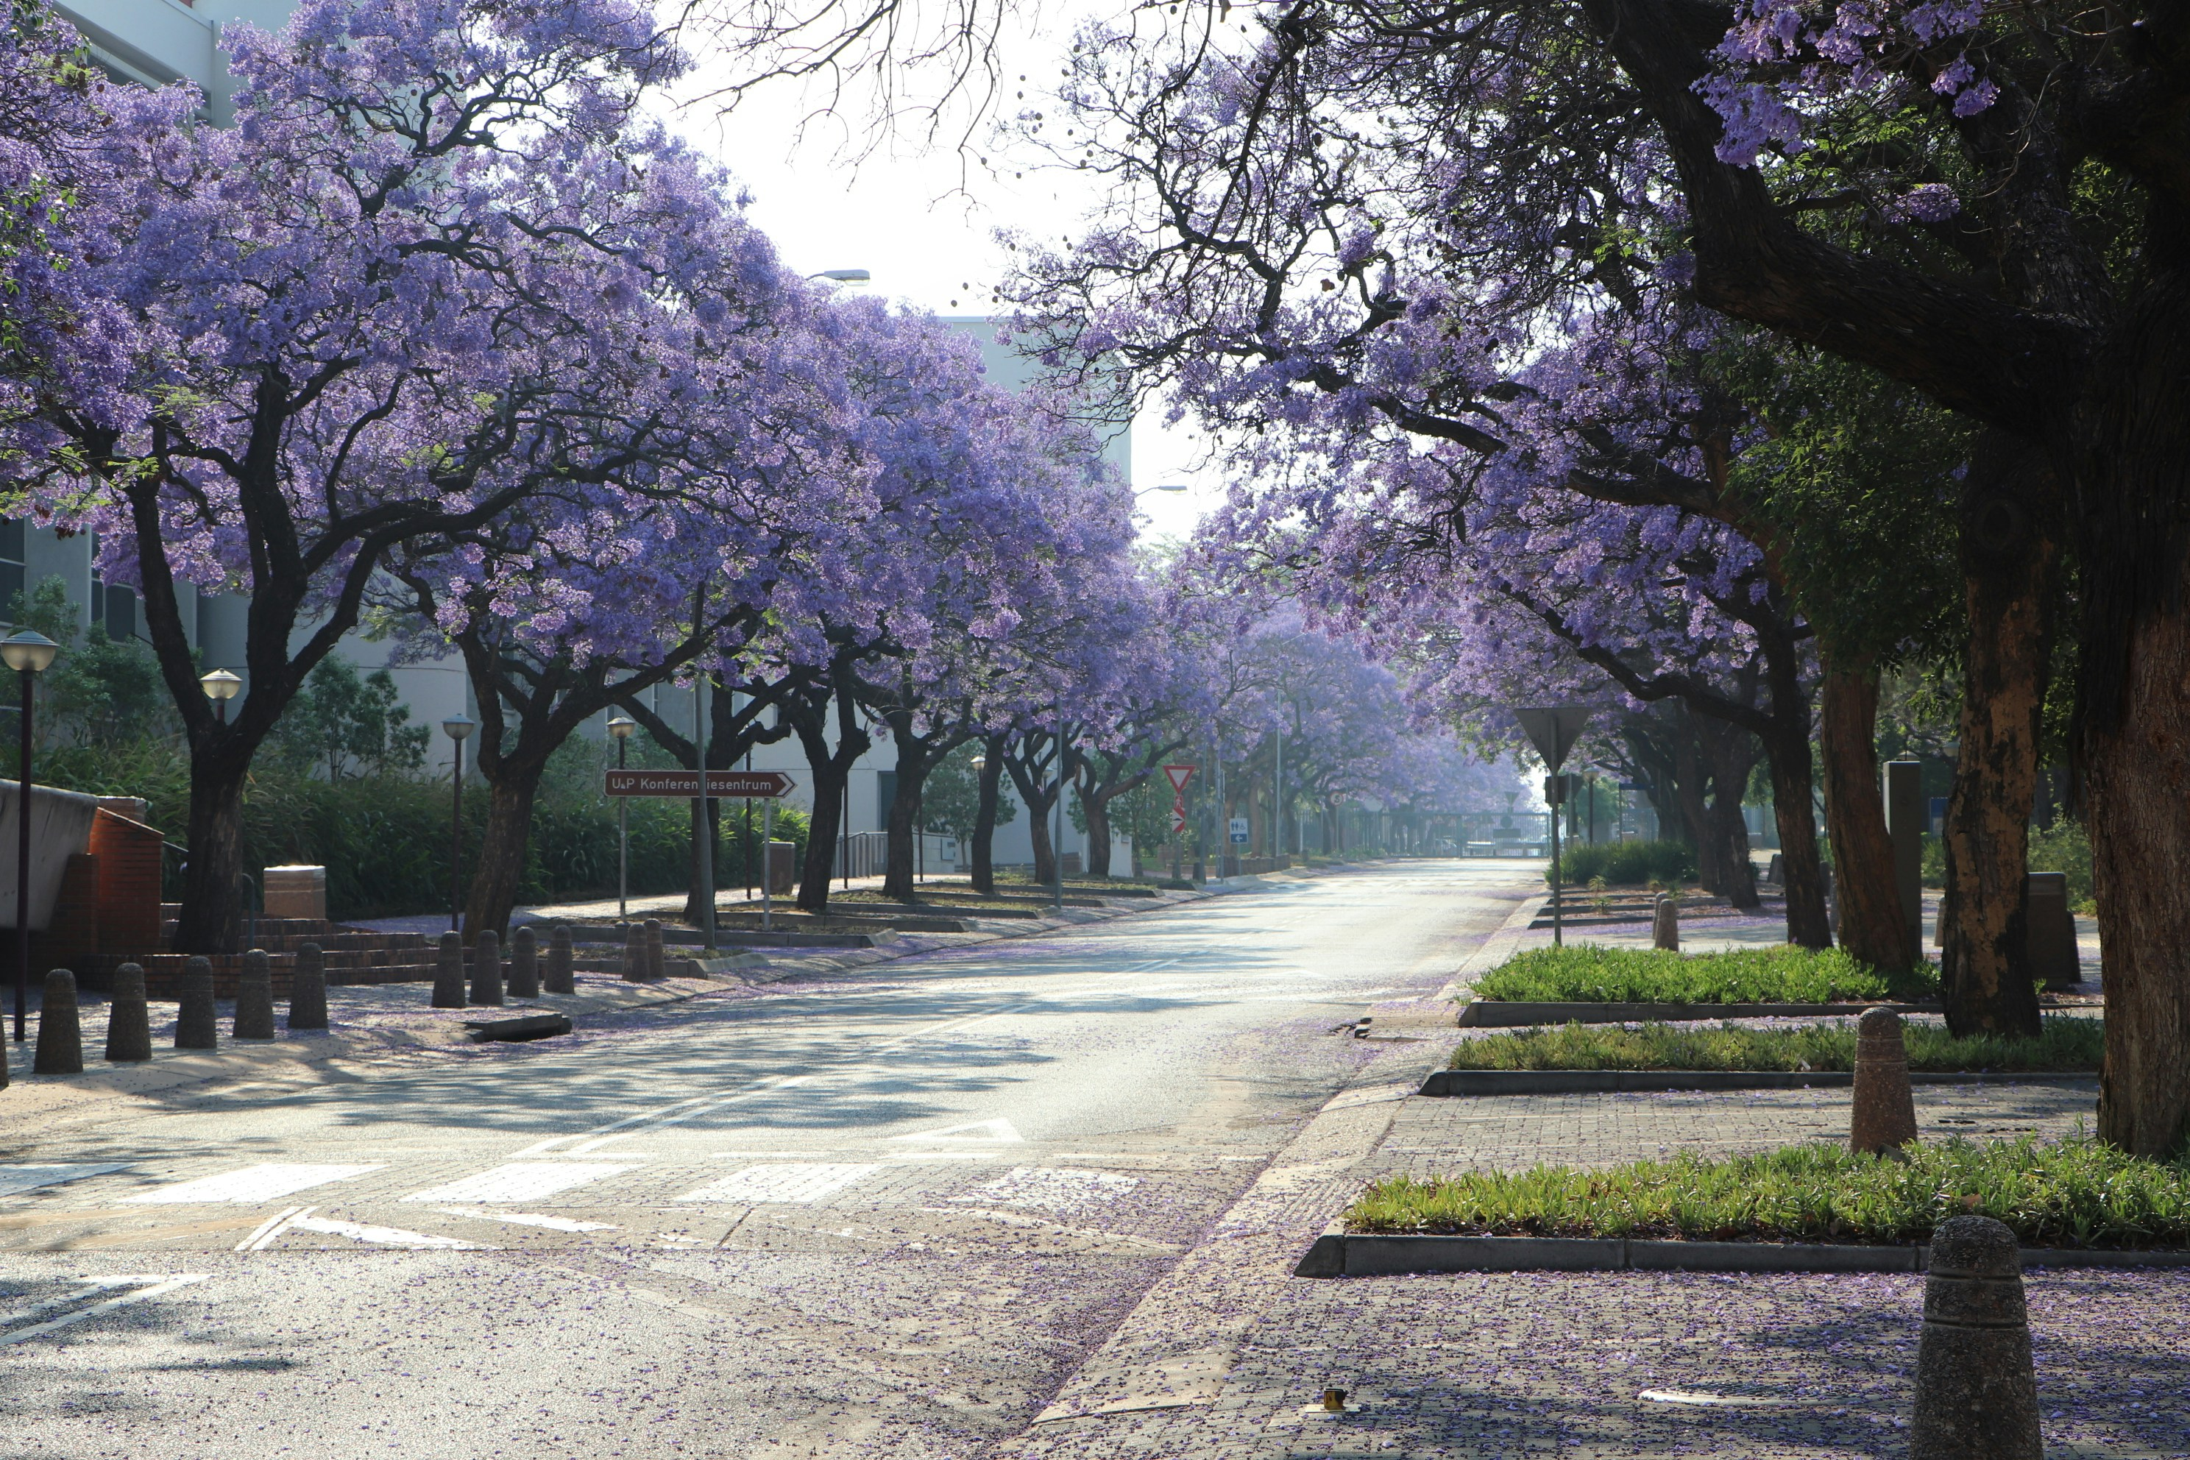
FUNCTIONAL
REQUIREMENTS
City Management: Oversee city infrastructure, utilities, and citizen well-being; simulation adapts in real-time or turn-based modes.
Building Construction: Construct residential, commercial, industrial, and landmark buildings with unique costs and impacts.
Utility Management: Manage utilities (power, water, waste) to ensure efficient city operation and citizen satisfaction.
Transportation: Build roads and transit to reduce commute times, traffic congestion, and boost connectivity.
Citizen Management: Handle population dynamics, employment, services, and government policy impacts.
Government & Policies: Control taxes, budget, and policies that influence growth and citizen contentment.
Resource Allocation: Track resources (materials, energy) and manage budgets to support city expansion.
Economic Growth: Set tax rates, fund services, and foster economic activity for sustained development.
City Growth Dynamics: Simulate growth in population, economy, and infrastructure, driven by policies and resources.
Component Interactions: Integrate buildings, utilities, transportation, and policies to create a cohesive, responsive city ecosystem.

Slide 9
ASSUMPTIONS

Slide 10
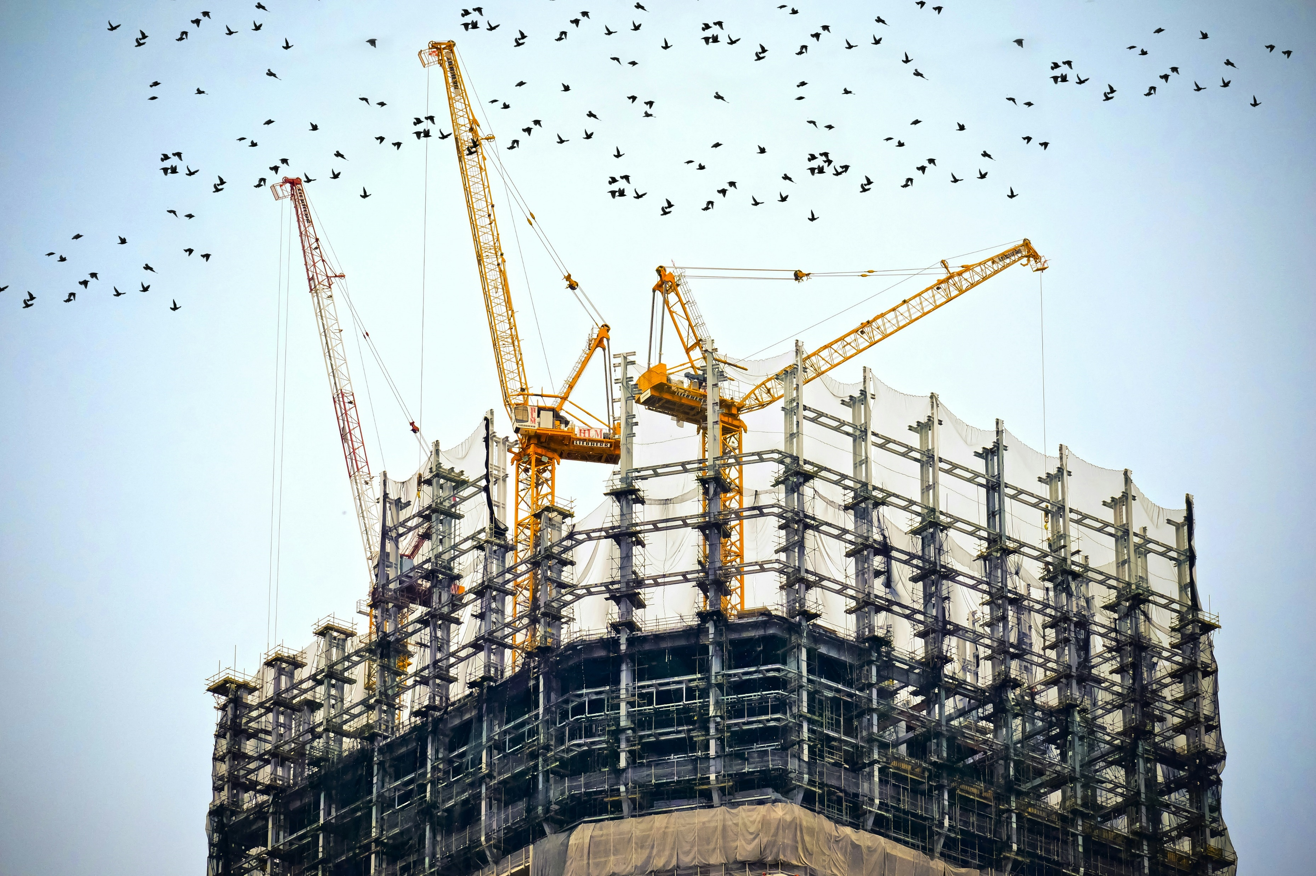
ASSUMPTIONS
New citizens only arrive from a highway thus no need to handle an exponential population growth .
Tax would only be collected from one source (Citizens, shops, factories) at a time .
Residents only have 5 states of satisfaction. It is not an 0 to 100 scale like with most city builders .
Residential buildings will always exist before a citizen so homeless citizens are not a factor .
Buildings may have only one type (Residential, Commercial, Industrial). No combination of multiple buildings exists .
Citizens can only live in one residential building. They cannot have 2 houses.

Slide 11
IDENTIFIED
PATTERNS

Slide 12
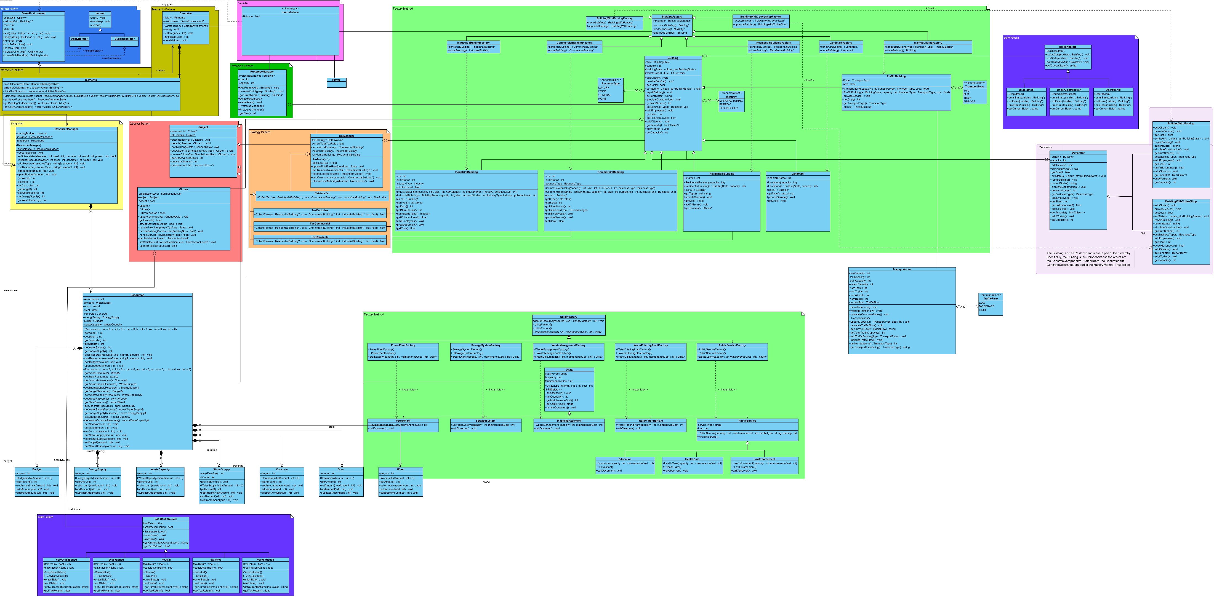
SYSTEM
UML

Slide 13
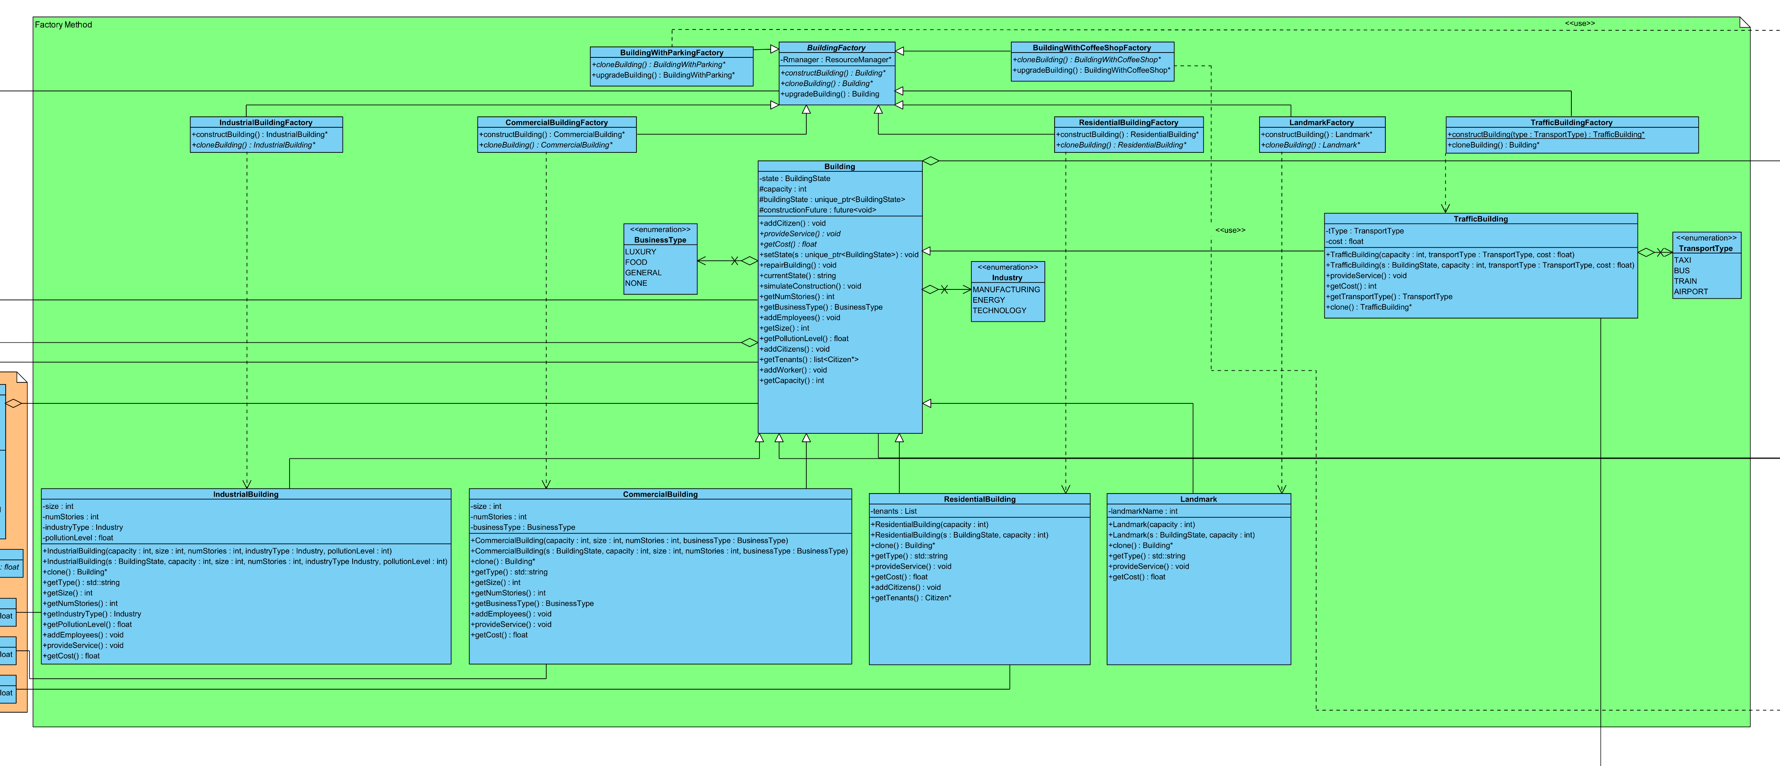
SINGLETON
Purpose: Ensure that there is only one instance of a class that manages critical shared resources like power plants, water supply, or the city budget.
Justification: You want to avoid having multiple conflicting instances of resource management systems. A single global instance ensures consistent resource allocation and proper tracking.
Participants: Singleton - ResourceManager

Slide 14
FACTORY
Purpose: : Simplify the creation of complex objects such as buildings (residential, commercial, industrial) by using a Factory that abstracts the instantiation process.
Justification: Buildings have different attributes, and using a Factory allows you to create objects based on specific conditions without exposing the creation logic. This keeps the system flexible as new types of buildings can be added easily.
Participants: Creator - BuildingFactory
ConcreteCreator - IndustrialBuildingFactory, CommercialBuildingFactory, ResidentialBuildingFactory, LandmarkFactory, TrafficBuildingFactory, BuildingWithCoffeeShopFactory, BuildingWithParkingFactory
Product - Building
ConcreteProduct - IndustrialBuilding, CommercialBuilding, ResidentialBuilding, Landmark, TrafficBuilding, BuildingWithCoffeeShop, BuildingWithParking

Slide 15
FACTORY
Purpose: : Simplify the creation of complex objects such as buildings (residential, commercial, industrial) by using a Factory that abstracts the instantiation process.
Justification: Buildings have different attributes, and using a Factory allows you to create objects based on specific conditions without exposing the creation logic. This keeps the system flexible as new types of buildings can be added easily.
Participants: Creator - BuildingFactory
ConcreteCreator - IndustrialBuildingFactory, CommercialBuildingFactory, ResidentialBuildingFactory, LandmarkFactory, TrafficBuildingFactory, BuildingWithCoffeeShopFactory, BuildingWithParkingFactory
Product - Building
ConcreteProduct - IndustrialBuilding, CommercialBuilding, ResidentialBuilding, Landmark, TrafficBuilding, BuildingWithCoffeeShop, BuildingWithParking

Slide 16
FACTORY
Purpose: : Simplify the creation of complex objects such as buildings (residential, commercial, industrial) by using a Factory that abstracts the instantiation process.
Justification: Buildings have different attributes, and using a Factory allows you to create objects based on specific conditions without exposing the creation logic. This keeps the system flexible as new types of buildings can be added easily.
Participants: Creator - BuildingFactory
ConcreteCreator - IndustrialBuildingFactory, CommercialBuildingFactory, ResidentialBuildingFactory, LandmarkFactory, TrafficBuildingFactory, BuildingWithCoffeeShopFactory, BuildingWithParkingFactory
Product - Building
ConcreteProduct - IndustrialBuilding, CommercialBuilding, ResidentialBuilding, Landmark, TrafficBuilding, BuildingWithCoffeeShop, BuildingWithParking

Slide 17
OBSERVER
Purpose: The Observer pattern allows citizens to "observe" changes in city conditions (e.g., new buildings, policies, or infrastructure changes) and update their satisfaction levels accordingly.
Justification: : By using the Observer pattern, the simulation can notify citizens when events occur that impact their satisfaction, making the system more efficient and decoupling citizen management from the city engine.
Participants: Subject - Subject ConcreteSubject - Building , TaxManager ConcreteObserver - Citizen

Slide 18
STATE
Purpose: Allow an object to change its behaviour when its internal state changes, tracking the state of buildings (e.g., UnderConstruction, Operational, Dilapidated) and citizens' satisfaction levels (e.g., Satisfied, Neutral, Dissatisfied).
Justification: : The State pattern is used to manage both building states and citizen satisfaction states, allowing dynamic transitions between states based on actions or external conditions. This improves the flexibility of the simulation in reflecting changes over time.
Participants (Citizen State): State - SatisfactionLevel ConcreteState - VeryDisappointed, Disappointed, Neutral, Satisfaction,Very Satisfied Context - Citizen

Slide 19
STATE
Purpose: Allow an object to change its behaviour when its internal state changes, tracking the state of buildings (e.g., UnderConstruction, Operational, Dilapidated) and citizens' satisfaction levels (e.g., Satisfied, Neutral, Dissatisfied).
Justification: : The State pattern is used to manage both building states and citizen satisfaction states, allowing dynamic transitions between states based on actions or external conditions. This improves the flexibility of the simulation in reflecting changes over time.
Participants (Building State): State – BuildingState ConcreteState - UnderConstruction, Operational, Dilapidated Context - Building

Slide 20
ITERATOR
Purpose: Provide a way to sequentially access the elements of a collection (e.g., utilities or buildings) without exposing their underlying implementation.
Justification: : The Iterator allows you to loop through all utilities or buildings efficiently, checking their statuses without needing to know how they are stored.
Participants: Iterator - Iterator ConcreteIterator - UtilityIterator, BuildingIterator ConcreteAggregate - GameEnvironment

Slide 21
DECORATOR
Purpose: Dynamically add or modify the functionality of buildings without altering their base class
Justification: The Decorator pattern allows for dynamically extending or modifying buildings’ functionality (e.g., upgrading to add a coffee shop or parking lot thus also capacity and employment opportunities) without modifying the base Building class. This provides flexibility in upgrading buildings as the simulation progresses.
Participants: Component - Building
ConcreteComponent - IndustrialBuilding, CommercialBuilding, ResidentialBuilding, Landmark, TrafficBuilding, BuildingWithCoffeeShop, BuildingWithParking
Decorator - Decorator
ConcreteDecorator - BuildingWithCoffeeShop, BUildingWithParking

Slide 22
STRATEGY
Purpose: Define a family of algorithms for taxation policies (e.g., Citizen tax, Factory tax) and resource allocation strategies, allowing the city simulation to switch between them dynamically.
Justification: Different taxation strategies can be applied based on the city's economic conditions, and by using the Strategy pattern, you can easily swap between different approaches without altering the rest of the system.
Participants: Context - TaxManager
Strategy - RetrieveTax
ConcreteStrategy - TaxFactories, TaxResidents, TaxCommercial

Slide 23
PROTOTYPE
Purpose: Provide a means to create buildings and decorated buildings without having to use large amounts of memory for creation.
Justification: The Prototype pattern allows objects to be created without significant computational resource usage and given how complex the project is, this is a pivotal method for building creation.
Participants: Prototype - Building ConcretePrototype - IndustrialBuilding, CommercialBuilding, ResidentialBuilding, Landmark, TrafficBuilding, BuildingWithCoffeeShop, BuildingWithParking Client - PrototypeManager

Slide 24
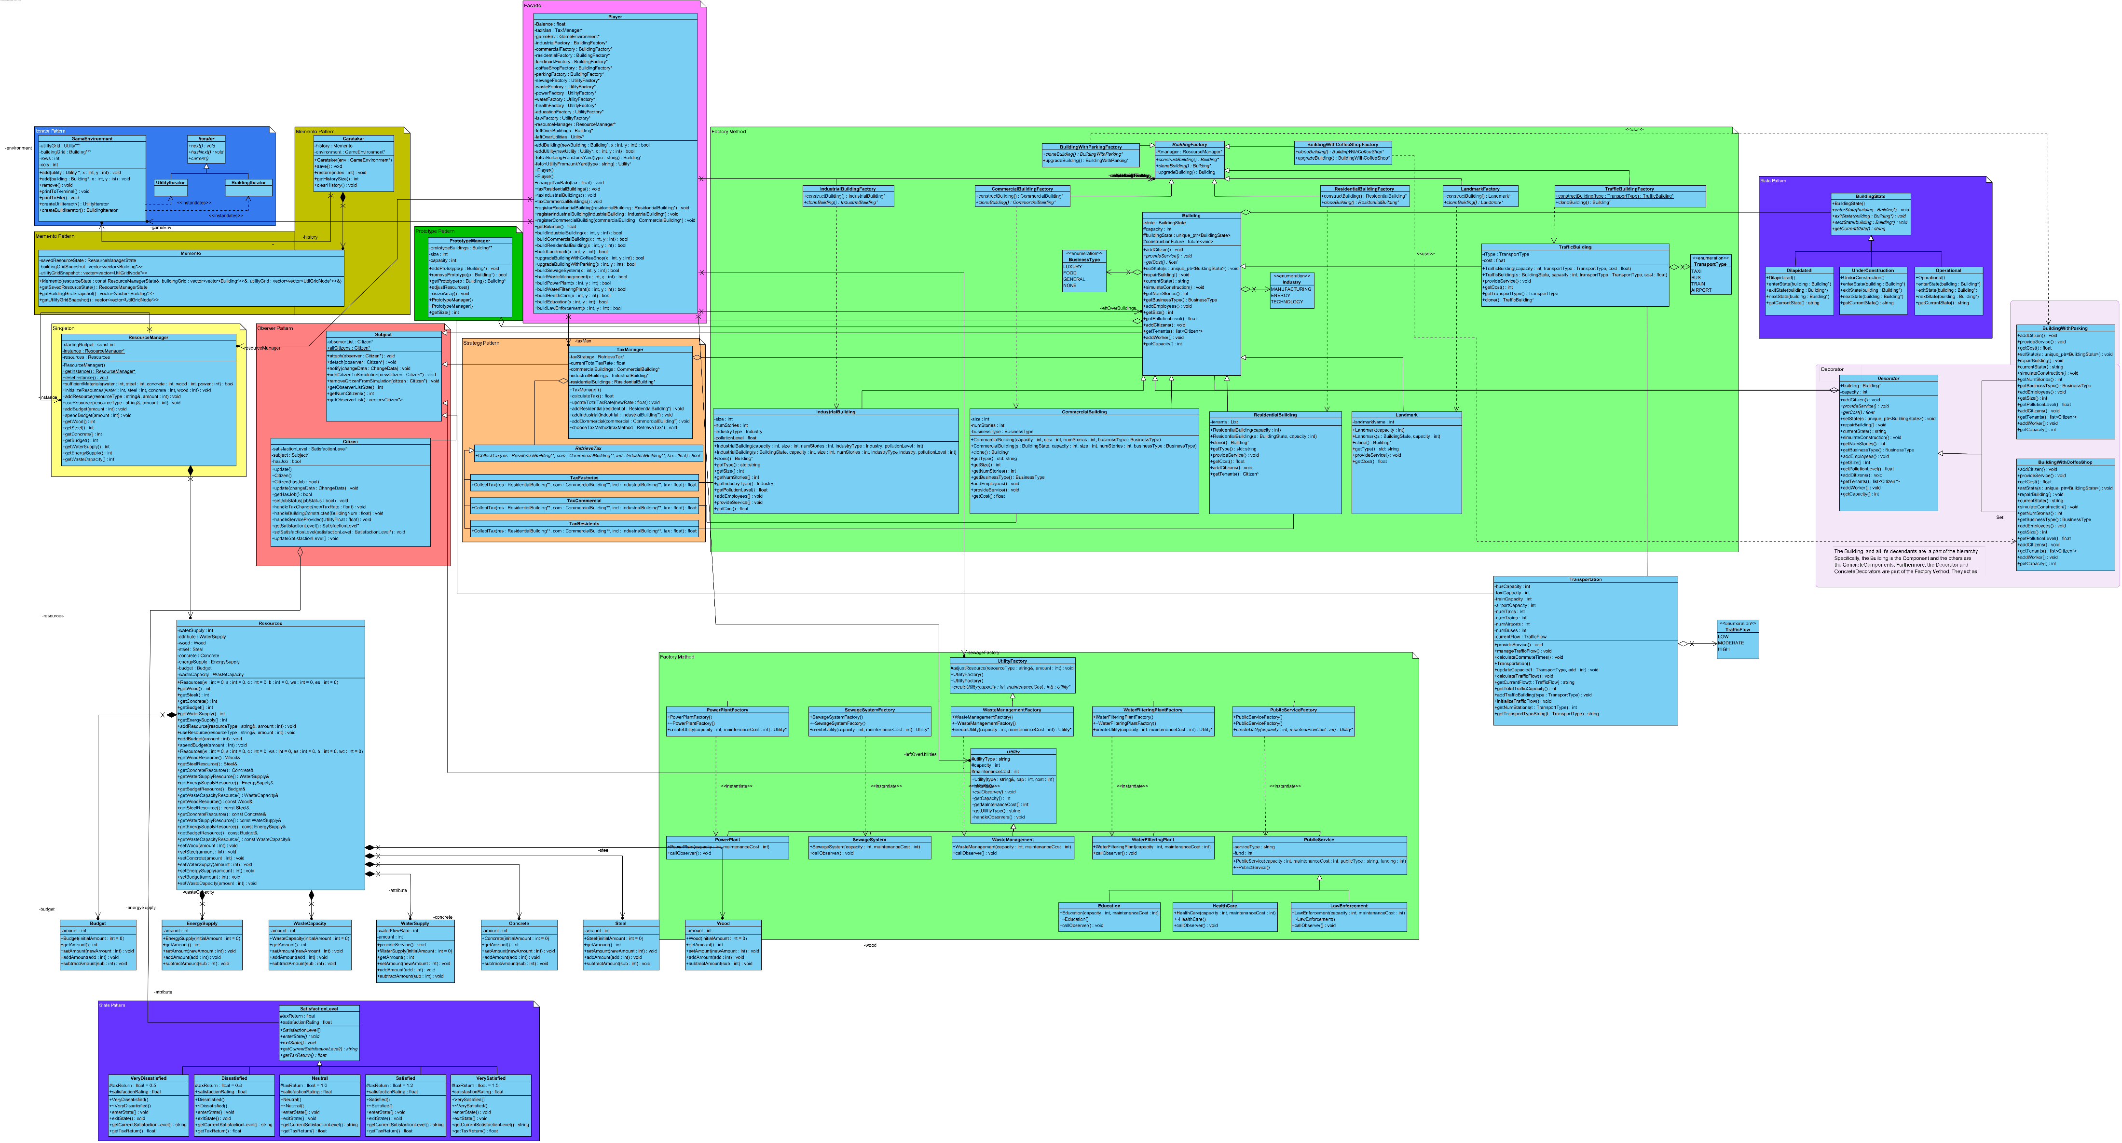
MEMENTO
Purpose: Capture and restore an object’s internal state without violating encapsulation, allowing for saving and restoring game state.
Justification: The Memento pattern is crucial for capturing the full game state and restoring it later, allowing players to save and load the simulation at any point. This ensures smooth game continuity.
Participants: Originator - GameEnvironment Memento - CityArchives Caretaker - Caretaker

Slide 25



FAÇADE
Purpose: Provide a simplified interface to a complex subsystem (e.g., the simulation engine that handles resource management, citizen interactions, and transportation).
Justification: The Facade will offer a clean API for interacting with the simulation engine, making it easier for other parts of the system to perform high-level operations without needing to understand the complexity beneath.
Participants: Façade - Player
SubSystems - The entire project

Slide 26



UNIT TESTING
Test
C++ Testing Framework

Slide 27
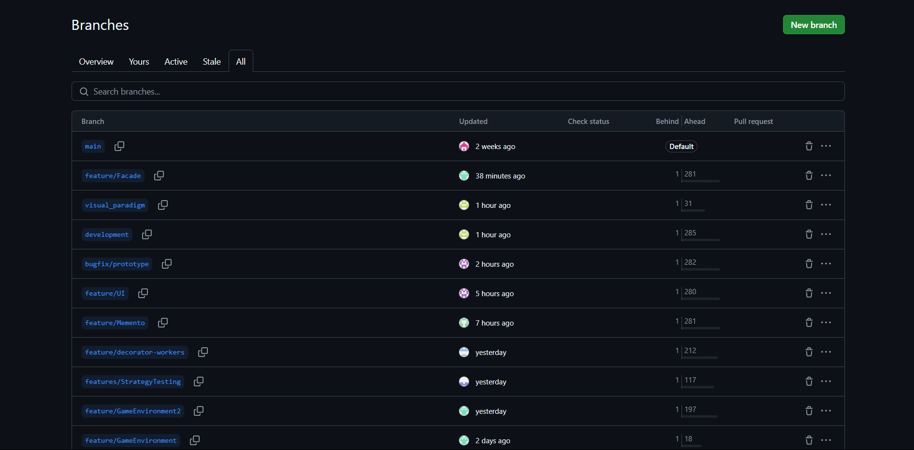
GITHUB

Slide 28


GITHUB
GitFlow Branching Strategy
main (Final Product)
development (Testing of Individual Components Together)
feature/[system feature] (Separate Feature Implementations)
bug/[implementation issue] (Implementation Issues That Need to Be Solved)

Slide 29
GITHUB

Slide 30
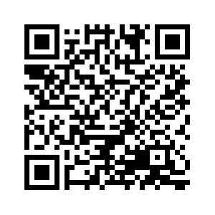

SURVEY
Let us know on how we can improve!

